Slide 1
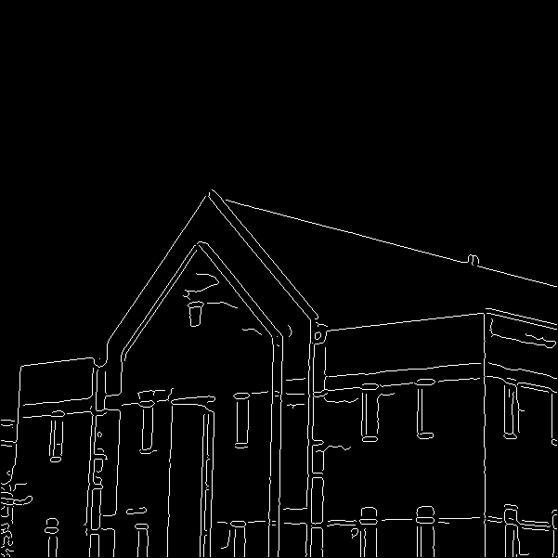
Home Work
Following is an edge image. Draw the 10 most explicit straight lines using Hough Transform on the edge image.
2. Choose the straight lines which are within +- 10 degree from the horizontal axis among the above 10 lines.

